Slide 1
DIFFERENT METHODS OF SAMPLING

Slide 2
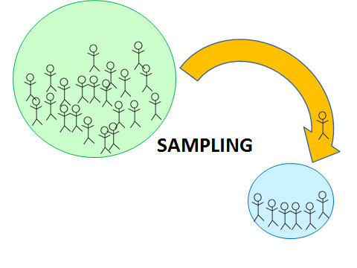
SAMPLING
Sampling is a process used in statistical analysis in which a predetermined number of observations are taken from a larger population.

Slide 3
METHODS OF SAMPLING
Classified into 2 types:
Probability Sampling Methods (random sampling)
Non-probability Sampling Methods (non random sampling)

Slide 4
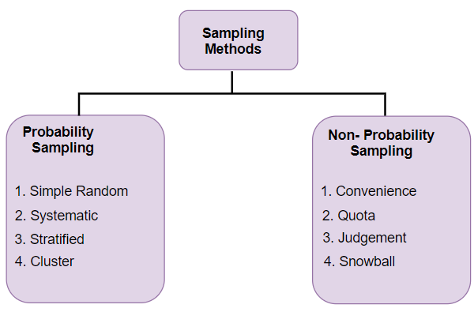
Methods of sampling

Slide 5
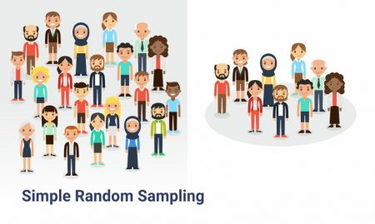
Probability sampling: Simple Random Sampling
Every item/data in a population has an equal chance of being selected in a sample

Slide 6
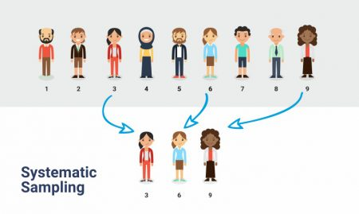
Systematic sampling
Arranges population in an order and select at regular interval

Slide 7
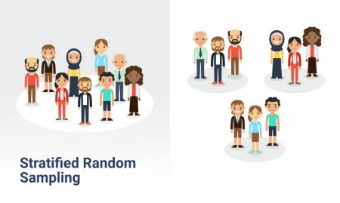
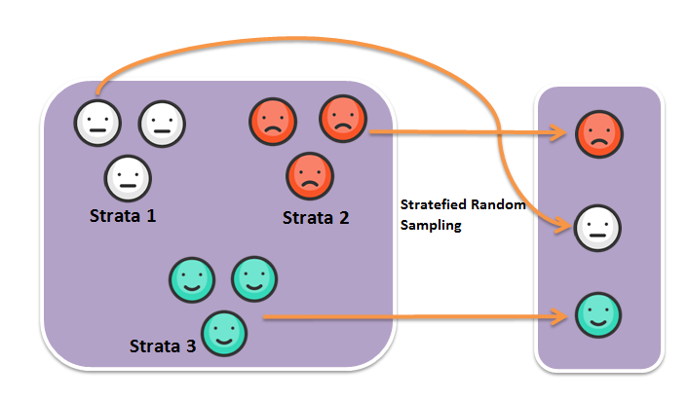
Stratified sampling
Population is divided into separate groups called strata, and sampling is done for each groups

Slide 8
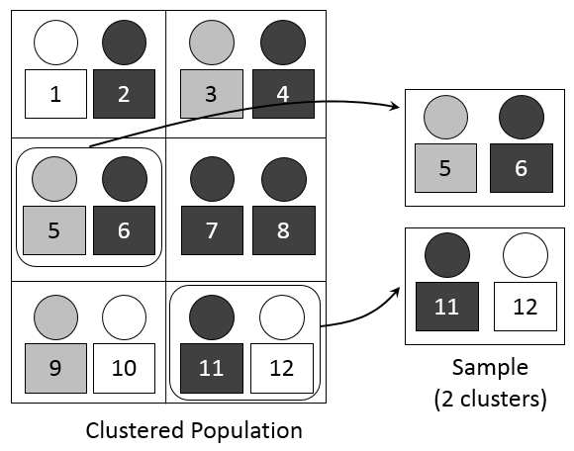
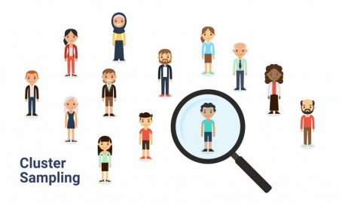
Cluster sampling
Population is divided into separate groups called cluster, and simple random sample of cluster is selected from the population

Slide 9
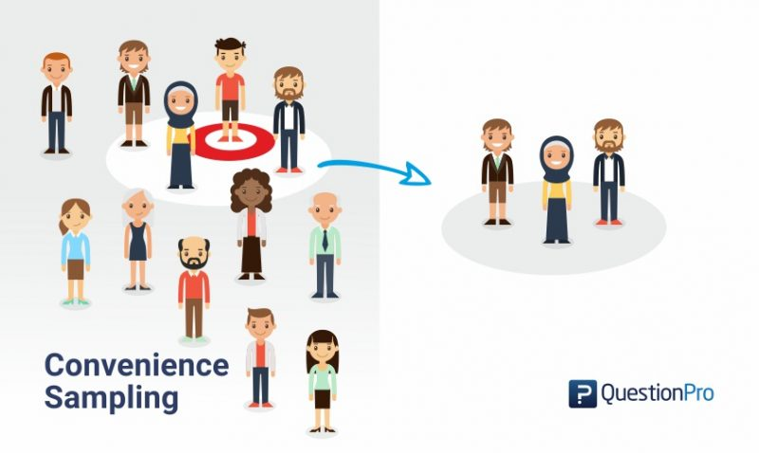
Non probability sampling: Convenience sampling
With people who are close to reach
Otherwise known as grab sampling, accidental sampling or opportunity sampling

Slide 10
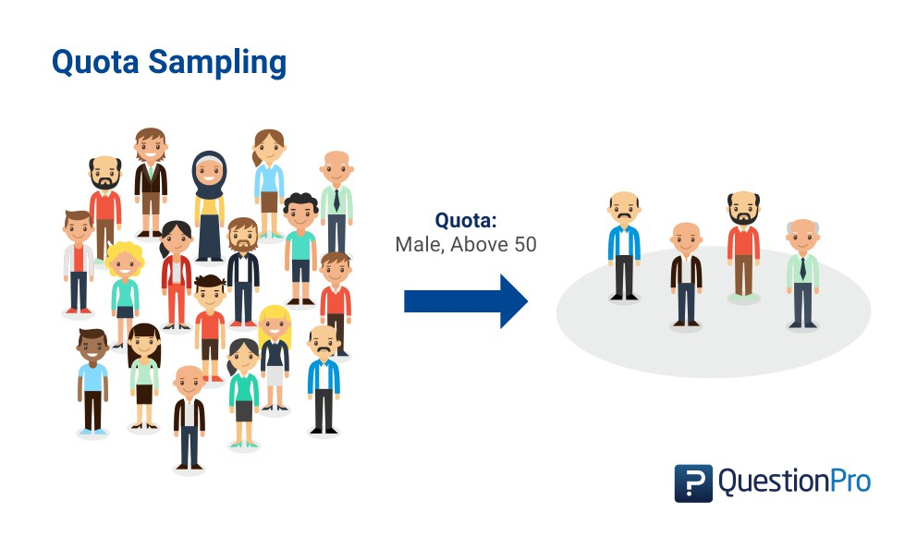
Quota sampling
In proportion with some characteristics of the population, e.g.. Gender, education level, income etc.

Slide 11
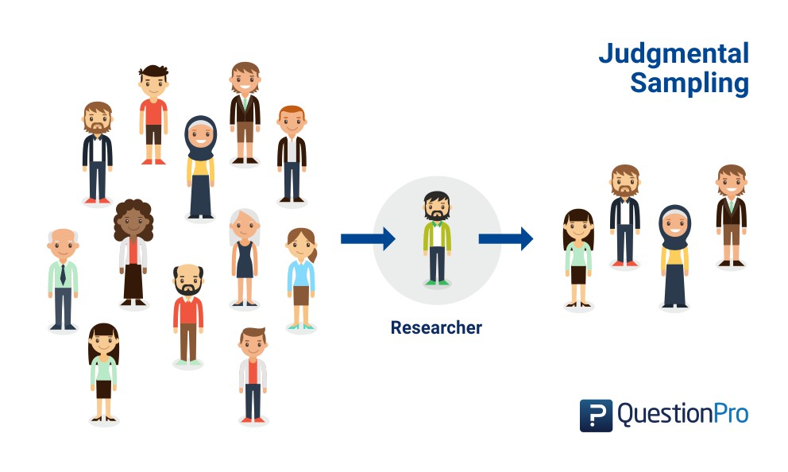
Judgemental sampling
sample members are chosen only on the basis of the researcher's knowledge and judgment.

Slide 12
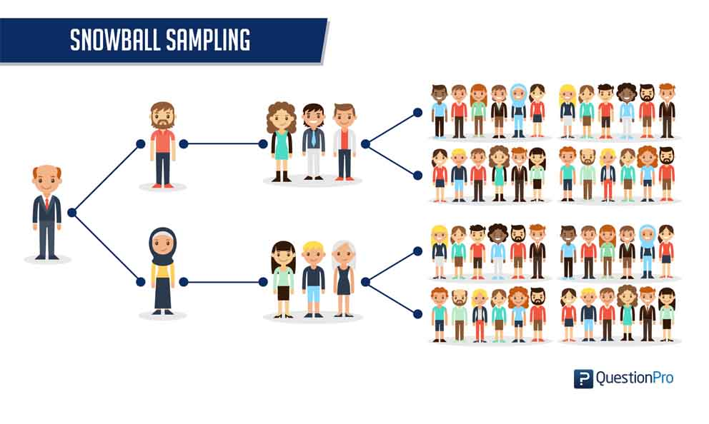
Snowball sampling
participants recruit other participants for a test or study, used where participants are hard to find. It's called snowball sampling because (in theory) once you have the ball rolling, it picks up more “snow” along the way and becomes larger and larger.

